Slide 1
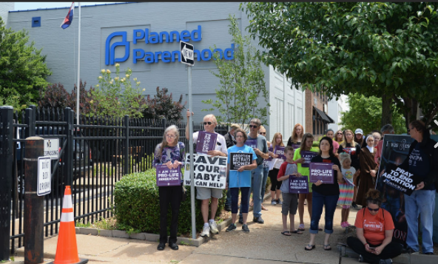
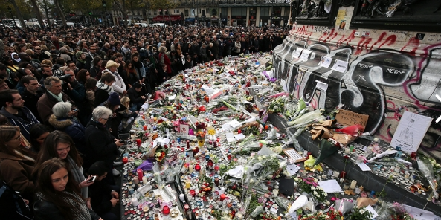
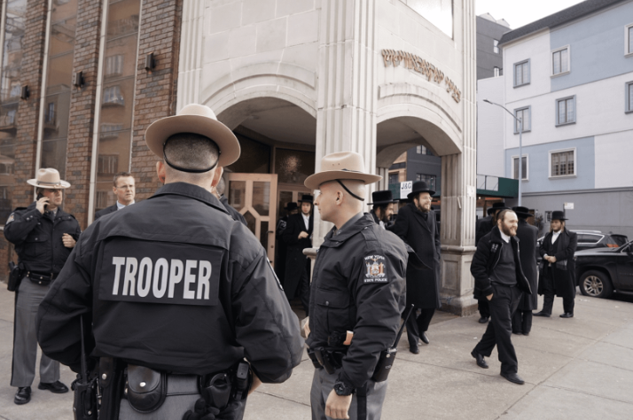
2023 Nonprofit Security Grant Program (NSGP)
Bidder’s Workshop
9:00 a.m. Thursday March 16, 2023

Slide 2
2023 Nonprofit Security Grant Program (NSGP)
The NSGP is a competitive grant program providing federal funding (FEMA) for physical security enhancements and other security-related activities to nonprofit organizations that are at risk of a terrorist attack.
The NSGP seeks to enhance the ability of nonprofit organizations to prevent, prepare for, protect against, and respond to terrorist or other extremist attacks and are part of a comprehensive set of measures to help strengthen the nation’s communities against potential terrorist or other extremist attacks.
NSGP-S vs NSGP-UA
Period of Performance (POP) is 36 months
September 1, 2023 – August 31, 2026*
Notes:
* May be extended via formal written request to the recipients FEMA Preparedness Officer and must contain specific and compelling
justifications as to why an extension is required. Recipients are advised to coordinate with
the FEMA Preparedness Officer as needed when preparing an extension request. Please refer
to the Preparedness Grants Manual for more detail on the requirements for submitting an
extension request.

Slide 3
NSGP Eligibility
Nonprofit organizations designated as an IRS 501(c)(3) entity and exempt from tax under section 501(a) of the Internal Revenue Code.
Organizations such as churches, mosques, and synagogues are considered exempt if they meet the requirements of section 501(c)(3) and do not have to apply for and receive recognition of exemption form the IRS.
Able to demonstrate, through the application (Investment Justification- IJ), that the organization is at high risk of a terrorist attack.
Tax Exempt Organization Search
Tax Exempt Organization Search (irs.gov)

Slide 4
NSGP Eligibility
What types of organizations are not eligible under NSGP?
Utility companies
For-profit transportation companies and hospitals
Organizations active in politics, lobbying and advocacy work
Volunteer fire departments
Community Service Organizations (Kiwanis, Rotary, and Lions clubs)
Labor, agricultural or horticultural organizations
i.e. labor unions, county fairs, and flower societies

Slide 5
2023 Nonprofit Security Grant Program (NSGP) Resources
The NSGP seeks to integrate the preparedness activities of nonprofit organizations with broader state and local preparedness efforts.
National Preparedness Goal
National Preparedness Goal | FEMA.gov
Idaho Preparedness Efforts
Community Preparedness | Office of Emergency Management (idaho.gov)
FY23 NSGP NOFO / Guidance / Core Capabilities / FAQ
The Department of Homeland Security (DHS) Notice of Funding Opportunity (NOFO) Fiscal Year 2023 Nonprofit Security Grant Program | FEMA.gov
Preparedness Grants Manual | FEMA.gov (appendix C)
Mission Areas and Core Capabilities | FEMA.gov
Fiscal Year 2023 Nonprofit Security Grant Program – FAQ
Notes:
As of 2/28/23 there is no NPSG FAQ so the quick start guide link is substituted.

Slide 6
2023 NSGP Funding Landscape
Idaho (recipient) target allocation: $2,250,000
Applicant (subrecipient) may apply for up to $150,000 per site (up to 3- IJ required for each site*)
2023 NSGP Process
Three phases:
State Administrative Agency (SAA)= IOEM
Notes:
*A nonprofit organization may procure resources covering similar purposes across multiple sites, but the quantities and costs must be broken down by site in each IJ -

Slide 7
2023 NSGP Allowable Costs
Planning- Security or emergency planning expenses and the materials required to conduct planning activities.
Must relate to the protection of the facility and the people within and should include consideration of individuals with access and functional needs as well as those with limited English proficiency.
Examples of planning activities include (but not limited to):
Development / enhancement of security plans
Emergency contingency or Continuity of Operations Plans
Evacuation / Shelter in place plans
Emergency Response Plans

Slide 8
2023 NSGP Allowable Costs
Training / Exercise- Limited to an organization’s security personnel, staff, members and volunteers only.
Offsite or onsite security training for employees or members of the organization
Train the trainer courses
Response Exercises for long-term vulnerability reduction
Training costs are limited to attendance fees and related expenses (materials, supplies and equipment)
Travel is not a reimbursable cost

Slide 9
2023 NSGP Allowable Costs
Training / Exercise-
Allowable training / exercise topics include physical and cybersecurity, target hardening and terrorism awareness / employee preparedness topics such as Community Emergency Response Team (CERT) training, active shooter training, and emergency first aid training.
Applicants should include specific details about any proposed training/exercises, to include topic, organizational attendees / participants, length, and what vulnerability the activity will help mitigate.

Slide 10
2023 NSGP Allowable Costs
Equipment- Authorized Equipment List (AEL) Categories 14 & 15 only; examples include:
Authorized Equipment List | FEMA.gov
For additional guidance on using FEMA grant funding to purchase equipment refer to the latest SAFECOM publication here:
FY 2022 SAFECOM Guidance on Emergency Communications Grants (cisa.gov)
Access Control Equipment Surveillance Equipment (Cameras) Impact Resistant Doors and Gates Intrusion Detection Sensors and Alarms Exterior Lighting | Physical Perimeter Security (fencing, walls, jersey barriers) Screening and Inspection Equipment Backup computer hardware, operating system, data storage, and application software

Slide 11
2023 NSGP Allowable Costs
Personnel- Contracted security protection is the only allowable cost in this category under NSGP.
Funds may not be used to purchase equipment for contracted security.
Applicant should justify proposed contracted security personnel spending in the target hardening narrative section of the application.
Sustainment planning for non-NSGP-funded contract personnel capability will be required as part of the closeout package.
i.e. number of personnel, frequency of use, hourly rate
Notes:
The nonprofit organization must be able to sustain the contract personnel capability in future years without NSGP funding, and a sustainment plan will be required as part of the closeout package for any award funding this capability. Cap: may not use more than 50% of their awards to pay for personnel activities unless a waiver is approved by FEMA

Slide 12
2023 NSGP Allowable Costs
Management and Administration (M&A)-
Up to 5% of a subrecipient’s FY 2023 NSGP award may be used for M&A purposes.
Examples include reporting, financial management, correspondence and monitoring.
Justify M&A budget in Section IV of the Investment Justification to fully account for the project budget.
Operational costs are not allowed.

Slide 13
2023 NSGP Unallowable Costs (not exhaustive)
Organizational operating costs Hiring of public safety personnel General-use expenditures Overtime Development of risk / vulnerability assessments License plate reader systems Facial recognition software Knox boxes Guns / weapons Landscaping | Initiatives that enhance federal property Initiatives which study technology development Proof of concept initiatives Any pre-award costs Sexual predatory screening database Development of the investment justification Weapons training

Slide 14
2023 NSGP Review Process
FEMA review priorities-
Mission Statement: used to validate Investment Justification and to categorize facility (faith-based, education, medical, other).
Completed vulnerability assessment: identifies the threats and vulnerabilities specific to the facility / site identified in the application.
Completed Investment Justification (IJ): must be a physical address- no P.O. Box Numbers, one site and one address per IJ, organization must occupy the site at the time of the application.
Supporting Documentation: supports threat to facility, if applicable, such as police or insurance reports.

Slide 15
2023 NSGP Review Process
FEMA review priorities-
Mission Statement: use official letterhead, provide the ‘who, what and why’ of the organization, state purpose of organization and any policies / practices that may elevate risk.
Vulnerability Assessment (VA): VA is the foundation upon which the IJ is built, the VA addresses threats, vulnerabilities and consequences of potential events at a site or location; equipment should directly link to the threats, vulnerabilities, and potential consequences to the site.
While there are no specific requirements for the VA, applicants are encouraged to engage someone with a security, law enforcement, military or emergency service background to conduct the VA.
(example VA for houses of worship)
https://www.cisa.gov/publication/houses-worship-security- self-assessment

Slide 16
2023 NSGP Review Process
Investment Justification-
Describes the ‘who, what, when, where, why’ and how of the plan to harden targets.
Submitted in the required IJ pdf fillable form. Pdf link for fema_fy-23-nsgp-investment-justification
All 7 Parts need to be fully addressed.
Submissions in any other format than the provided IJ form are not allowed.
Should be consistent with the findings of the VA and address target hardening initiatives that will mitigate identified vulnerabilities.
Establishes the project timeline and milestones for completion of proposed investments and identifies key individuals that will be involved in implementing and administering the award.

Slide 17
2023 NSGP Application
Welcome to Office of Emergency Management (idaho.gov)
File Submission Naming Convention:
IJ: FY2023_NSGP_S_ID_(Nonprofit name)_IJ
VA: FY2023_NSGP_S_ID_(Nonprofit name)_VA
Mission Statement on letterhead: FY2023_NSGP_ID_(Nonprofit name)_MS

Slide 18
2023 Nonprofit Security Grant Program (NSGP)
Investment Justification- the template provided is required to apply for NSGP
Bonus review points (as in FY 22)
Underserved Communities as determined by The Social Vulnerability Index (SVI): Interactive Map | CDC
+10 points for ‘high’ SVI rating, +15 points for ‘very high’ SVI rating
Most recent data, 2020, shows a high vulnerability index for Shoshone, Washington, Elmore, Gooding and Owyhee counties.
Novice recipients receive +15 points

Slide 19
2023 Nonprofit Security Grant Program (NSGP)
Investment Justification- important information
Latest version of Adobe Reader required
Use ‘save as’ function to populate the IJ
Browser guidance: Chrome- least friendly, Firefox most friendly
Notes:
No browser guidance is in the nofo. According to www.makeuseof.com “The PDF tools in Mozilla's browser are widely considered to be the best outside of dedicated PDF apps.”

Slide 20
2023 Nonprofit Security Grant Program (NSGP)
NEW Changes to Entity Administrator: On March 3, 2023 only employees of an entity can hold the Entity Administrator role in SAM.gov.
On April 4, 2022, the unique entity identifier used across the federal government changed from the DUNS Number to the UEI number (generated by SAM.gov).
Existing registered entities can find their UEI by following the steps here.
New entities can get their UEI at SAM.gov and, if required, complete an entity registration. I manage an entity. What do I need to do?
For more information about this transition, visit SAM.gov or the Federal Service Desk, FSD.gov. You can search for help at FSD any time or request help from an FSD agent Monday–Friday 8 a.m. to 8 p.m. ET.
Not having a UEI does not prohibit a nonprofit from applying for NSGP, however an award will not be issued until the subapplicant has established a UEI.
Notes:
SAM.gov | Duns - Sam UEI

Slide 21
2023 NSGP Review Process
SAA (initial review)
Verify eligibility (IRS status, physical site/s)
Validate organization type using mission statement (faith-based, education, medical or other)
Review and score all complete applications
Rank all applications by funding priorities (level of threat and proposed activities to ameliorate threat)

Slide 22
2023 NSGP Review Process
Timeline:
Pre-award workshop for potential applicants: March 16, 2023 at 9 am
IJ submission to SAA deadline: Friday, April 14, 2023 by 5 pm MDT or 4 pm Pacific Daylight Time (PDT)
Submission email: IOEMfinance@imd.Idaho.gov
SAA submission of funding priority slate to FEMA: May 18, 2023
Awards announced no later than Summer, 2023
Period of Performance begins September 1, 2023

Slide 23
2023 NSGP Resources
FEMA FY23 NSGP Technical Assistance Webinar
Fiscal Year 2023 Nonprofit Security Grant Program Technical Assistance Webinar | FEMA.gov
Subapplicant Quick Start Guide
Fiscal Year 2023 Nonprofit Security Grant Program (NSGP) Subapplicant Quick Start Guide | FEMA.gov
All required files are available on Grants.gov. Make sure to download the FY 2023 versions!

Slide 24
Questions:
Matt McCarter Kari Harneck
Grants Branch Chief Finance Section Chief
IOEM IOEM
mmccarter@imd.Idaho.gov Kharneck@imd.Idaho.gov
(208)258-6517 (208)258-6564

