Slide 1
Managing Unsolicited Donated Goods

Slide 2
Objectives
  Describe why cash donations are more economically feasible than donated goods.
  Define requirements for collection centers.
  List types of distribution centers.
  Summarize the benefits of operating through recovery.

Slide 3
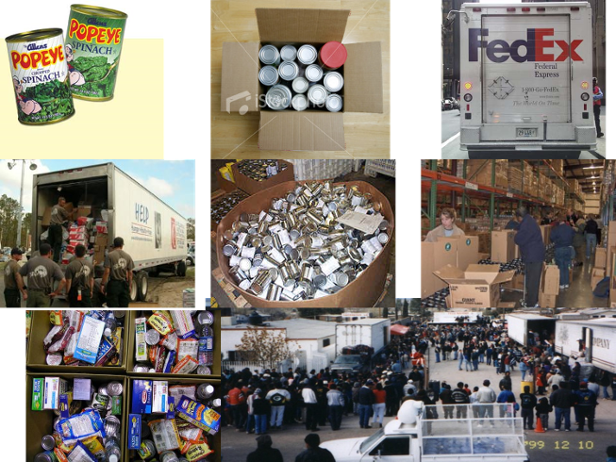

Slide 4


Slide 5
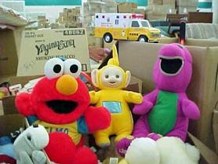
Reality is . . .
Even though you "just say no" . . .
. . . goods will still come and a facility to manage those goods may be required.

Slide 6
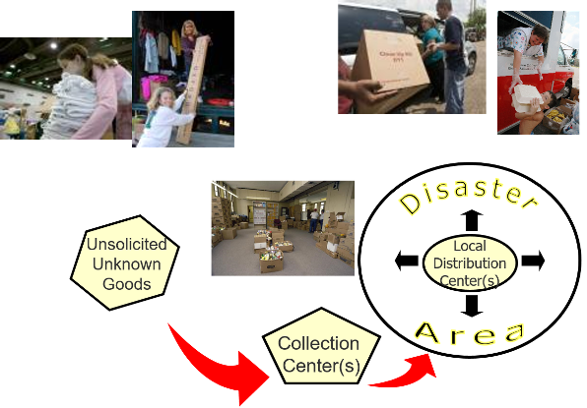
Managing the Flow of Donations

Slide 7
Collection Centers
  Often public sites for collecting unsolicited goods
  Converts "Stuff" to "Goods"

Slide 8
Collection Centers (Continued
  Develop a plan to operate and demobilize a collection center
  Identify, sort, inventory, and prepare items for distribution
  Consider structure for distribution
    Voluntary agencies
    Faith-based organizations
    Survivors at distribution centers
  Record and document process

Slide 9
Information Management
  Inventory Tracking
  Systems may be interrupted
  Create redundancy with layers
    Web-based technology
    Non-networked computer
    Paper forms that duplicate electronic entries

Slide 10
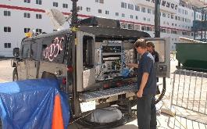
Communications
  External
    VDCT
    Distribution Centers
    Incoming Trucks
    Others?
  Internal
    Between sections and key personnel
    (use walkie-talkies)

Slide 11

Discussion Question | What makes a good distribution center? What are possible locations for distribution centers?

Slide 12
Discussion Question | Are there advantages to maintaining a collection center through recovery?

Slide 13

Manage Those Goods!
Activity | Manage Those Goods! Review the scenario and read additional information. Answer the questions/issues to consider. Summarize your responses on the easel chart. Be ready to report to the class.

Slide 14
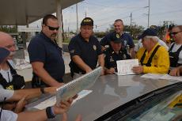
Pulling it all together . . .
Preparedness/Planning
  Know your team
  Establish MOUs
  Develop phone scripts
  Include SOPs
  Develop triggers for action
  Manage public education

Slide 15
Pulling it all together . . . (Continued)
Response
Activating the plan . . .
  Public information
  Information management
  Matching needs
  Making changes as needed
  Monitoring staffing
  Working toward recovery
  Demobilizing

Slide 16
Pulling it all together . . .
Recovery
For the long haul
  Making the transition
  Transferring management
  Appealing to public for long term
  Thanking donor
  Establishing After-Action process

Slide 17
What's In Your Annex?
  Does your annex: Discuss procedures for handling an influx of unsolicited goods?
  List a mechanism for locating collection and distribution centers?
  Designate people responsible for unsolicited goods?
  Discuss criteria for opening and closing collection and distribution centers?

Slide 18
Summary
  Describe why cash donations are more economically feasible than donated goods.
  Define requirements for collection centers.
  List types of distribution centers.
  Summarize the benefits of operating through recovery.

