Slide 1
Information Management

Slide 2
Objectives
Describe what technologies can be used to accept and track offers.
Establish procedures for matching offers to the needs identified.
Identify information management system(s) to help match offered resources to identified needs.

Slide 3
Discussion Questions
Discussion Question | Why is it best for local jurisdictions to match offers to needs instead of managing stuff and people? How do local jurisdictions match offers to needs?

Slide 4
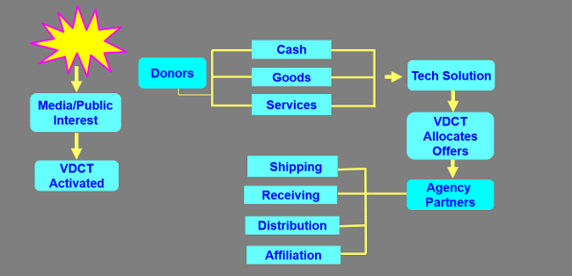
Volunteer and Donations Process

Slide 5
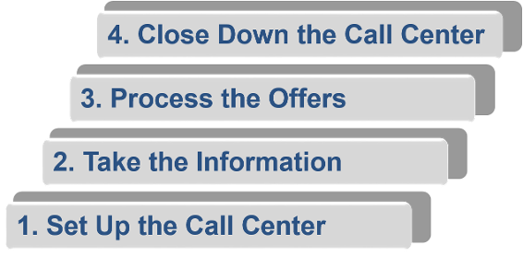
Information Management Operations
Four Steps:

Slide 6
The Need for a Call Center
Determined by: Media attention
An overwhelming number of phone calls to the EOC and agencies offering donations

Slide 7
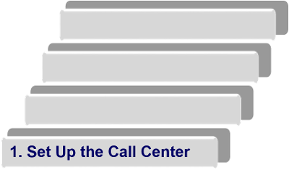
Set Up the Call Center
Considerations:
Space/location
Hours of operation
Equipment
Personnel
Key messages
Training

Slide 8
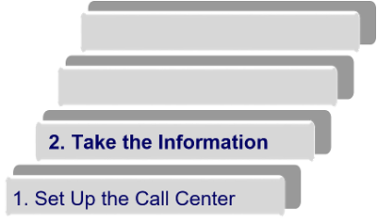
Take the Information
Update scripts as needed:
Input caller information and offer, if appropriate
Refer calls as necessary
Direct operator questions to supervisor

Slide 9
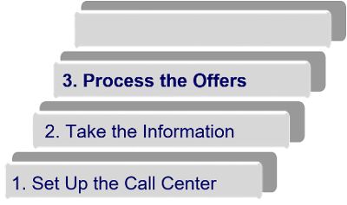
Process the Offers
Prioritize offers based on need
Allocate top-priority offers for immediate processing
Decline unneeded offers
Process all offers within 24 hours (preferably sooner!)

Slide 10
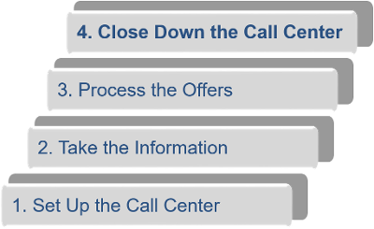
Close Down the Call Center
Distribute news release or announce on Website
Ensure all offers have been addressed
Ensure all donors and staff are thanked

Slide 11
Automated Information Management
Improves coordination and management of donations
Sorts offers of goods, cash, or services; searches for useful offers; and creates reports
Provides a central information clearinghouse
Maintains a list of specific needs
Ensures all offers are handled

Slide 12
Summary
Describe what technologies can be used to accept and track offers.
Establish procedures for matching offers to the needs identified.
Identify information management system(s) to help match offered resources to identified needs.

Slide 13
Post-Course Assessment

