Slide 1
Local Plans

Slide 2
Objectives
  Describe the planning considerations for annex development.
  Determine who needs to be involved in annex development.
  Explain the components of an annex to the local Emergency Operations Plan (EOP).
  Evaluate and compare annexes for key principles and strategies.

Slide 3
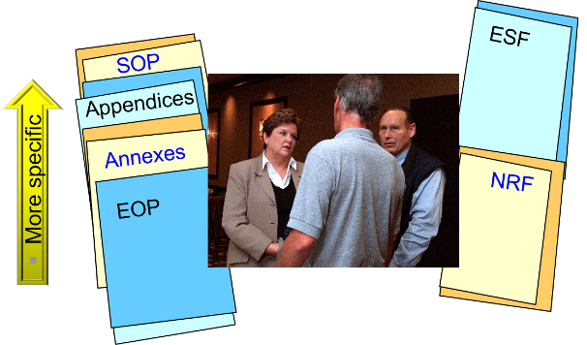
Planning Terminology and Considerations

Slide 4
Planning Considerations
  Why is an annex needed, who will develop it, and why is it important to get a team involved?
  What voluntary organizations should be involved in the process?
  Have lessons learned from previous exercises or operations been addressed?

Slide 5
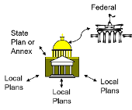
Planning Considerations (Continued)
  How will your annex interface with State, regional, and other local annexes?
  Are the assumptions sound and understandable?
  Is there commitment regarding roles and responsibilities?

Slide 6
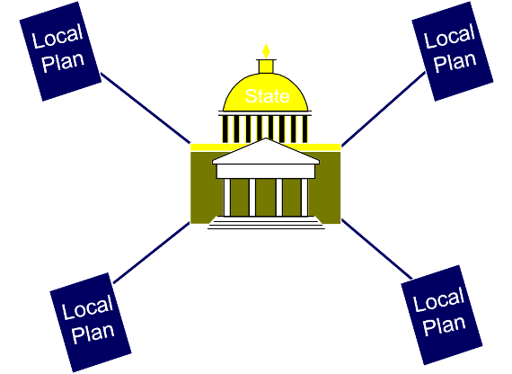
State and Local Coordination

Slide 7
Structural Components of an Annex
  An example of a format for an Annex:Primary agency: __________Supporting agencies: __________ Introduction/Purpose/Scope
  Policies
  Situation/Assumptions
  Concept of Operations

Slide 8
Structural Components of an Annex
  An example of a format for an Annex:Primary agency: __________Supporting agencies: __________ Responsibilities
  Resource Requirements
  References
  Terms and Definitions

Slide 9

Potential Pitfalls
  What are some potential pitfalls in developing and maintaining a Volunteer and Donations Management Annex?
  How can we overcome them?

Slide 10
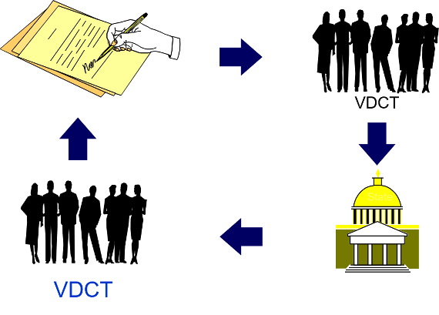
Approval Cycle

Slide 11

So Your Annex Is Finished. What's Next?
  What training schedule is there for stakeholders?
  What is the exercise schedule for the annex?
  When will the annex be revised?

Slide 12

Comparing and Contrasting Local Annexes
Activity | Comparing and Contrasting Local Annexes Individually (15 minutes) Review the annex using the Checklist and Comparison Summary Tool. Group discussion (15 minutes) Capture planning shortfalls and planning strengths on the easel. Report Out (10 minutes per group)

Slide 13
Summary
  Describe the planning considerations for annex development.
  Determine who needs to be involved in annex development.
  Explain the components of an annex to the local Emergency Operations Plan (EOP).
  Evaluate and compare annexes for key principles and strategies.

