Slide 1
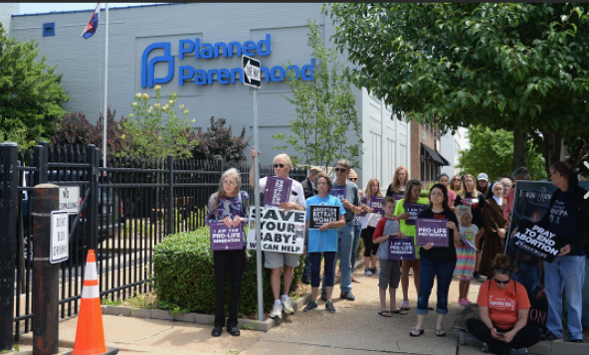
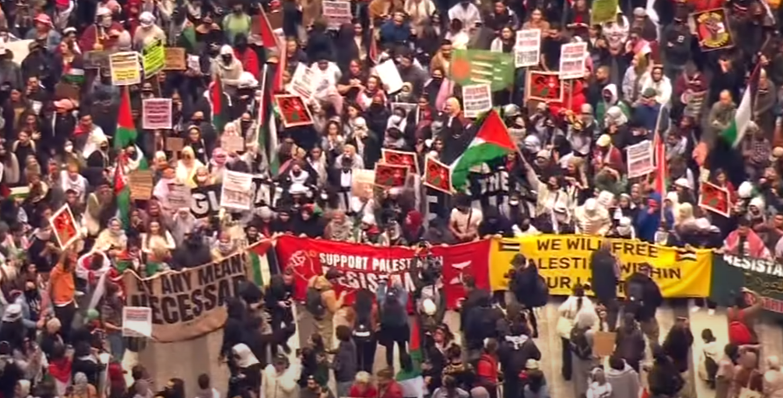
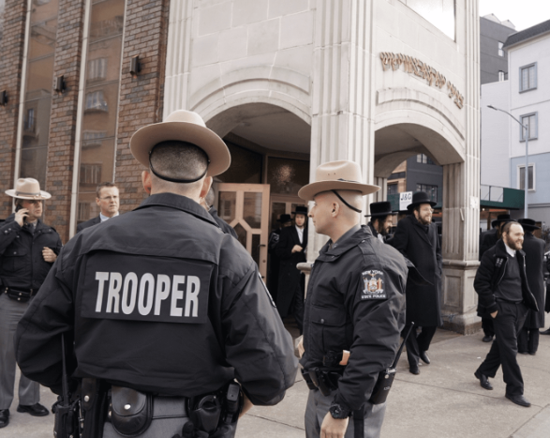

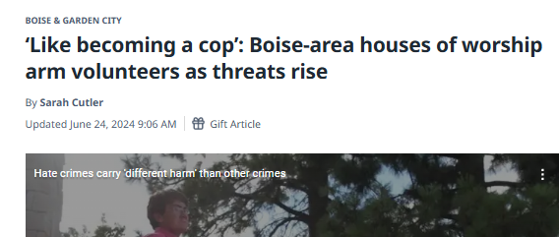
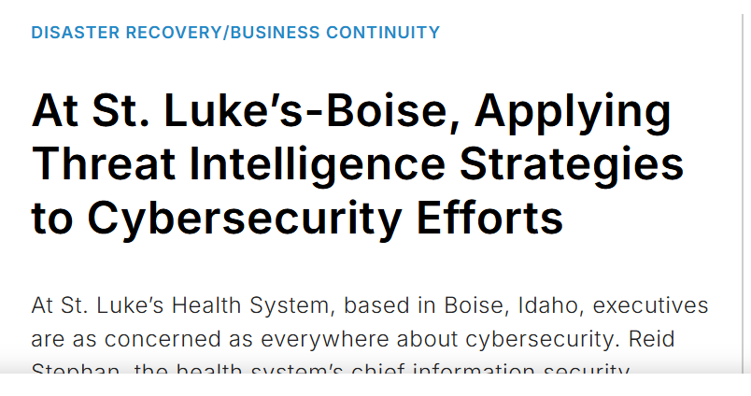
2025 Nonprofit Security Grant Program (NSGP)
Harden nonprofit targets against attack
Bidder’s Workshop
10/15/25, 2025

Slide 2
2025 Nonprofit Security Grant Program (NSGP)
The NSGP is a competitive grant program providing federal funding (FEMA) for security-related activities to nonprofit organizations that are at high risk of extremist attack.
The NSGP provides funding for physical and cybersecurity enhancements and other security-related activities to nonprofit organizations at high risk of terrorist or other extremist attacks. The program seeks to enhance the ability of nonprofits to prevent, prepare for, protect against, and respond to such threats while also integrating their preparedness activities with broader state and local preparedness efforts.
NSGP-S vs NSGP-UA
Period of Performance (POP) is 36 months
September 1, 2025 – August 31, 2028*
Notes:
* May be extended via formal written request to the recipients FEMA Preparedness Officer and must contain specific and compelling
justifications as to why an extension is required. Recipients are advised to coordinate with
the FEMA Preparedness Officer as needed when preparing an extension request. Please refer
to the Preparedness Grants Manual for more detail on the requirements for submitting an
extension request.

Slide 3
2025 Nonprofit Security Grant Program (NSGP)
Key Changes from FY24 to FY 25
NSGP-State award down 28% from FY24: $2,923,721 → FY25 $2,205,000
Subgrantee award max up from $150,000 to $200,000 per site (x3 max)
IOEM will conduct a competitive application process from 10/15 with a deadline of 11/21 5pm MT. Proposals will be submitted to IOEM, then forwarded to FEMA. Applicants are encouraged to review the Preparedness Grants Manual for guidance in addition to the NOFO.
Idaho Grant Management System GMS: https://gotomygrants.com. Activation of account / reset password emails come from no-reply@gotomygrants.com
Key FY25 Grant Changes for Subrecipients
Restrictions* on foreign nationals / new immigration conditions
Updated award termination provisions
Personnel transparency and vetting (IRS Form 990 on hand) *FFATA reporting
Compliance with Presidential Executive Orders (incl. E.O. 14148)
FEMA Information Bulletin (IB) 530 requirements
OMB Single Audit threshold raised to $1M
Enhanced financial oversight of reimbursements and payments
FY25, for the first time, FEMA is also offering a web version of the IJ, available at Grants.gov. Form FF-207-FY-21-115, OMB Control Number: 1660-0110.
Notes:
*Restrictions: If a sub applicant has foreign nationals, they must be properly vetted and must adhere to all government statues, polices, and procedures including “staff American, stay in America” and security requirements.
Updated Key Changes for Subgrantee Requirements (FY 2025)
Restriction on foreign nationals, noncitizens, and immigration conditions Today’s threats—including international and domestic terrorism, drugs, gangs, active shooters, targeted violence, transnational organized crime, and cyber—require federal, state, and local governments to leverage national capacity to effectively respond. Timely identification and analysis of key indicators from local, state, and federal partners enables all stakeholders to develop data-driven strategies that prevent, protect against, mitigate, and respond to threats while also protecting privacy, civil rights, and civil liberties. In alignment with these principles, subrecipients shall not include foreign nationals or non-citizens in sensitive roles or activities unless fully vetted and compliant with U.S. laws and DHS/FEMA security requirements. New immigration-related terms and conditions apply to all FY 2025 awards.
Updated award termination provisions Awards may be terminated for noncompliance with grant terms, failure to achieve program goals or meet DHS/FEMA priorities, or violations of applicable laws and regulations—consistent with 2 C.F.R. § 200.340.
Personnel transparency and vetting Subrecipients must provide names, addresses, biographies, and resumes for key personnel—including leadership and board members—for review and approval. To reduce burden, this requirement may be satisfied in part by using information already disclosed on IRS Form 990, which is public record and includes key leaders, officers, and compensation data. FEMA’s request is therefore consistent with transparency practices already familiar to nonprofit organizations. IOEM is compliant because staff data is listed on Transparent Idaho.
Compliance with Presidential Executive Orders Subrecipients must adhere to all relevant Presidential Executive Orders related to grants and federal financial assistance, including: • E.O. 14148 (“Initial Rescissions of Harmful Executive Orders and Actions,” Jan 20, 2025) which, along with FEMA’s IB 530, updates guidance on controlled and previously prohibited equipment; and • Reference to FEMA Information Bulletin (IB) 530 All subrecipients must follow FEMA Information Bulletin No. 530, which clarifies procurement and use of equipment in light of E.O. 14148 and provides administrative guidance for formerly restricted categories.
OMB Single Audit threshold update In accordance with revised OMB Uniform Guidance, the Single Audit threshold has increased from $750,000 to $1,000,000 in federal awards expended per fiscal year, effective for fiscal years beginning on or after October 1, 2024. Subrecipients expending $1,000,000 or more must conduct a Single Audit under 2 C.F.R. Subpart F.
Enhanced financial oversight on reimbursement and payment requests To strengthen accountability and ensure alignment with DHS/FEMA requirements, subrecipients should expect enhanced financial oversight of reimbursement and payment requests. This includes:
Rigorous internal controls and documentation of expenditures;
More frequent monitoring and risk-based reviews;
Increased emphasis on timely, complete financial reporting; and
DHS/FEMA’s authority to review, question, and validate all reimbursement submissions.

Slide 4
NSGP Eligibility
Nonprofit organizations designated as an IRS 501(c)(3) entity and exempt from tax under section 501(a) of the Internal Revenue Code.
Organizations such as churches, mosques, and synagogues are considered exempt if they meet the requirements of section 501(c)(3) and do not have to apply for and receive recognition of exemption from the IRS.
Able to demonstrate, through the application (Investment Justification- IJ), that the organization is at high risk of a terrorist or other extremist attacks.
Tax Exempt Organization Search
Tax Exempt Organization Search (irs.gov)

Slide 5
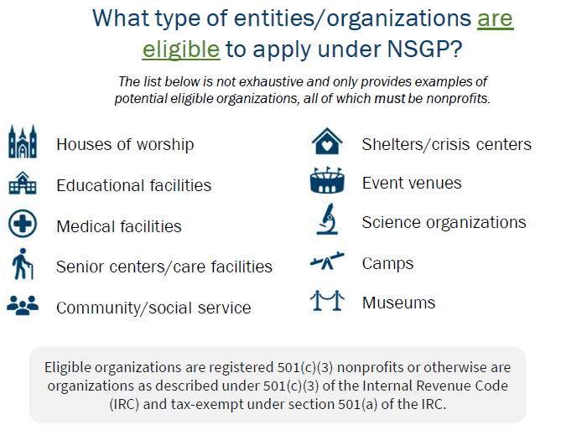
Notes:
Will there be an FY 25 version of the FY 2024 Spring Webinar Series Nonprofit Security Grant Program (NSGP)

Slide 6
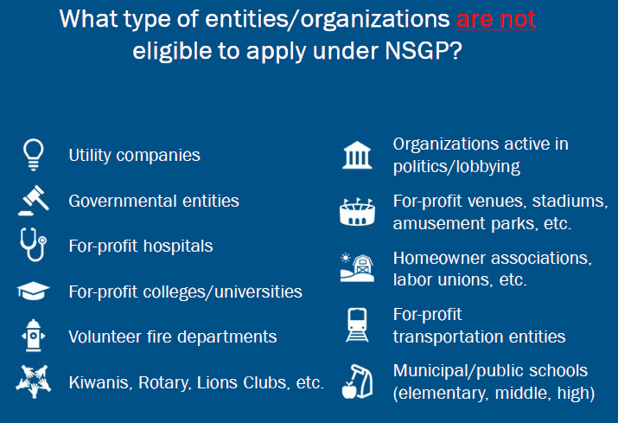

Slide 7
2025 Nonprofit Security Grant Program (NSGP) Resources
The NSGP seeks to integrate the preparedness activities of nonprofit organizations with broader state and local preparedness efforts.
National Preparedness Goal
National Preparedness Goal | FEMA.gov
Idaho Preparedness Efforts
Community Preparedness | Office of Emergency Management (idaho.gov)
FY25 NSGP NOFO / Guidance / Quick Start / FAQ
The U. S. Department of Homeland Security (DHS) Notice of Funding Opportunity (NOFO) Fiscal Year 2025 Nonprofit Security Grant Program | FEMA.gov
Fiscal Year 2025 Nonprofit Security Grant Program – FAQ
Fiscal Year 2025 Nonprofit Security Grant Program (NSGP) Subapplicant Quick Start Guide | FEMA.gov
Fiscal Year 2025 Preparedness Grants Manual(page 80)

Slide 8
National Preparedness Goal, Mission Areas
Preventing, avoiding, or stopping an imminent, threatened or an actual act of terrorism.
Protecting our citizens, residents, visitors, and assets against the greatest threats and hazards in a manner that allows our interests, aspirations, and way of life to thrive.
Mitigating / Reducing the loss of life and property by lessening the impact of future disasters.
Responding quickly to save lives, protect property and the environment, and meet basic human needs in the aftermath of an incident.
Recovering through a focus on the timely restoration, strengthening, and revitalization of infrastructure, housing, and a sustainable economy, as well as the health, social, cultural, historic, and environmental fabric of communities affected by an incident.
Notes:
Updated wording for the FY 25 Preparedness Manual
BLUF: The mission areas themselves have not changed in scope or structure from FY 23/FY 24 to FY 25. But the language has been updated slightly in FY 25: Added “imminent” in Prevention. Dropped “systems and networks” in Protection. Simplified Mitigation wording (“reduce” vs. “mitigating”). Changed Recovery wording to stress sustainability of the economy.
From Section 1.4 page 9
Prevention: Prevent, avoid, or stop an imminent, threatened, or actual act of terrorism.
▪ Protection: Protect our citizens, residents, visitors, and assets against the greatest threats and hazards in a manner that allows our interests, aspirations, and way of life to thrive.
▪ Mitigation: Reduce the loss of life and property by lessening the impact of future disasters.
▪ Response: Respond quickly to save lives, protect property and the environment, and meet basic human needs in the aftermath of an incident.
▪ Recovery: Recover through a focus on the timely restoration, strengthening, and revitalization of infrastructure, housing, and a sustainable economy, as well as the health, social, cultural, historic, and environmental fabric of communities affected by an incident.

Slide 9
2025 NSGP Funding Landscape
Idaho (recipient) target allocation: award = $2,205,000
Applicant (subrecipient) may apply for up to $200,000 per site (up to 3 sites - separate IJ required for each site*, up to total no more than $600,000)
2025 NSGP Process
Three phases of Application Review:
State Administrative Agency (SAA)= IOEM
Secretary,
Department of
Homeland
Security
SAA Review
FEMA Review
Notes:
*A nonprofit organization may procure resources covering similar purposes across multiple sites, but the quantities and costs must be broken down by site in each IJ, up to 3 sites (3 separate IJs)

Slide 10
2025 NSGP Allowable Costs
Planning- Security or emergency planning expenses and the materials required to conduct planning activities.
Must relate to the protection of the (specific) facility and the people within and should include consideration of individuals with access and functional needs as well as those with limited English proficiency.
Examples of planning activities include (but not limited to):
Develop, enhance, & strengthen security plans, protocols,& assessments
Emergency contingency, evacuation, & shelter-in-place plans
Coordination and info sharing with fusion centers
FEMA Guide for Developing Emergency Operations Plans for
Houses of Worship
Notes:
You will see lots of references to Houses of Worship. These resources work equally well for other applicants
The link is current as of 9.2.2025 –vjm. The most recent comprehensive guide from the U.S. Department of Homeland Security (DHS) and the Federal Emergency Management Agency (FEMA) for developing emergency operations plans (EOPs) for houses of worship is titled "Guide for Developing High-Quality Emergency Operations Plans for Houses of Worship." This guide was published over 12 years ago, in December 2012, and is available as a PDF document. U.S. Department of Homeland SecurityU.S. Department of Homeland Security
While this guide remains a foundational resource, there have been more recent publications and initiatives that support the safety and preparedness of faith-based communities:U.S. Department of Homeland Security
"Safety for Faith-Based Events and Houses of Worship" (published 8.3 years ago): This document emphasizes the importance of developing and practicing an Emergency Action Plan (EAP) and provides additional resources for houses of worship. U.S. Department of Homeland Security
FEMA's Center for Faith-Based and Neighborhood Partnerships: This center collaborates with faith and community leaders to promote whole community participation in disaster emergency response and recovery. They leverage emergency management tools and resources to ensure faith leaders and houses of worship are prepared when disaster strikes. FEMA+6U.S. Department of Homeland Security+6FEMA+6
For the most current information and resources, it's advisable to regularly check FEMA's website and the DHS Center for Faith-Based and Neighborhood Partnerships for updates and new publications.

Slide 11
2025 NSGP Allowable Costs
Training & Exercises
Training: For organization personnel, staff, members, and volunteers. Includes onsite/offsite training and train-the-trainer courses.
Security Exercises: Plan and conduct exercises to validate plans, assess capabilities, and identify gaps, including for individuals with access/functional needs.
Course details and budgeted costs must be in IJ
Costs: Covers fees, materials, supplies, and documentation.
Travel not reimbursable.
Guidance: Follow HSEEP principles; use After Action Reports and Improvement Plans to address gaps iteratively.
Notes:
Speaker’s Notes – Training & Exercises (FY25 NSGP)
Training:
Training is meant for your organization’s personnel, staff, members, and volunteers only.
This can include onsite or offsite security training, as well as train-the-trainer courses.
Costs the grant can cover include things like attendance fees, materials, supplies, and equipment.
Examples: Training under NSGP focuses on protecting critical infrastructure and key resources. This includes both physical security and cybersecurity, as well as facility hardening.
Awareness and preparedness training is also allowed, like terrorism or other extremism awareness, Active Shooter training, and Community Emergency Response Team (CERT) courses.
First aid and life-saving skills are encouraged, including “Stop the Bleed”, basic first aid, and AED or AED/Basic Life Support training, along with the necessary kits and equipment.
Travel, however, is not reimbursable.
Security-Related Exercises:
You can use funding to plan and run exercises, including covering meeting space, facilitation, materials, and documentation.
Exercises give your organization a safe, low-risk way to test plans and procedures, evaluate capabilities, and track progress toward your goals.
Any gaps you find—including needs for children or individuals with access or functional needs—should go into a dynamic Improvement Plan. The key is to continually monitor and implement corrective actions.
All exercises should follow HSEEP guidance for design, conduct, evaluation, and improvement planning.
Submitting your After Action Reports and Improvement Plans into FEMA’s Preparedness Toolkit helps track progress and strengthens your preparedness over time.

Slide 12
2025 NSGP Allowable Costs
Training / Exercises
Allowable training / exercise topics include physical and cybersecurity, target hardening and terrorism awareness / employee preparedness topics such as Community Emergency Response Team (CERT) training, active shooter training, and emergency AED and basic first aid training.
Applicants should include specific details about any proposed training/exercises, to include topic, organizational attendees / participants, length, costs and what identified vulnerability the activity will help mitigate.

Slide 13
2025 NSGP Allowable Costs
Equipment- Allowable costs are focused on facility hardening and physical security enhancements. Funding can be used for the acquisition and installation of security equipment on real property (including buildings and improvements) owned or leased by the nonprofit organization, specifically in prevention of and/or protection against the risk of a terrorist or other extremist attack.
NSGP allowable equipment is a subset of the AEL. Find the listing on pages 43-46 of the NOFO and in the dropdown menu of Section IV-B of the IJ.
Key Categories
Notification & Communication: PA systems, radios, repeaters, intercoms, paging.
Access & ID: Credentialing, access control, personnel/vehicle ID, screening.
Cybersecurity & IT: Authentication, encryption, malware protection, firewalls, IT backup.
Physical Security: Reinforced doors/gates, barriers, blast-resistant receptacles, sensors, lighting.
Video & Monitoring: Security cameras, acoustic sensors, infrastructure monitoring, alert software.
Notes:
Speaker’s Notes – Selected NSGP Authorized Equipment
Mass Notification & Public Address: Handheld or vehicle-mounted megaphones and PA systems for alerting large groups.
Signs & Access Control: Warning, caution, and restricted access signs; includes devices for individuals with access and functional needs.
Credentialing & Video Analytics: Systems for event/site credentials; video analytics software to detect threats (weapons detection allowed; license plate/facial recognition not allowed).
Public Alert & SaaS Applications: Systems to notify the public (sirens, EAS, IPAWS, WEA); cloud-based software supporting security systems and critical infrastructure.
Cybersecurity Tools: Remote authentication, encryption, malware/anti-virus protection, personal and network firewalls, intrusion detection/prevention systems.
Communications Equipment: Portable radios, repeaters, intercoms, paging systems, and accessories for alerting and coordination.
Power & Contingency Systems: Generators, uninterruptible power supplies (UPS), and IT contingency hardware/software for backup operations.
Blast & Impact Mitigation: Blast-resistant trash receptacles, reinforced doors and gates, impact-resistant building systems, and ballistic barriers.
Security Sensors & Monitoring: Alarm systems, acoustic sensor networks (gunshot/explosions detection), infrastructure monitoring sensors, fixed lighting, and video assessment systems.
Access & Identification Systems: Physical access control systems, personnel and vehicle ID systems (excluding license plate/facial recognition).
Screening Systems: Hand-held or walk-through magnetometers for personnel and package screening.
Installation Costs: Includes installation of all authorized FEMA grant-purchased equipment.

Slide 14
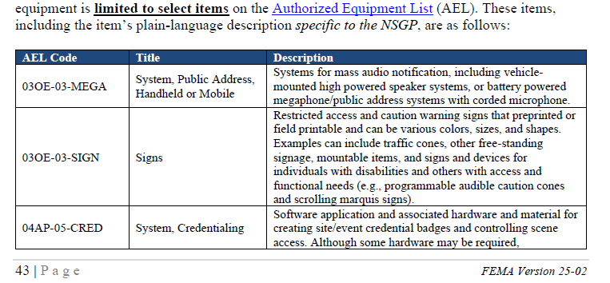
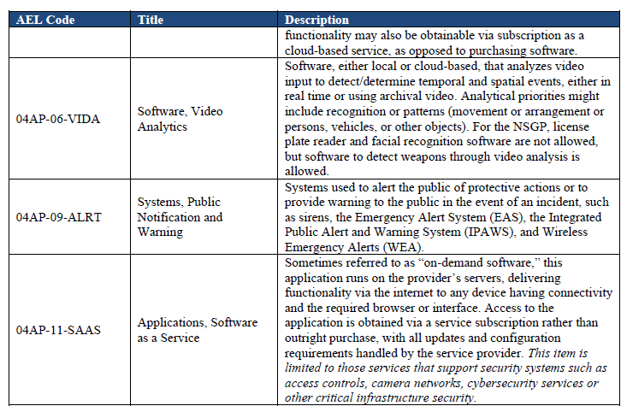
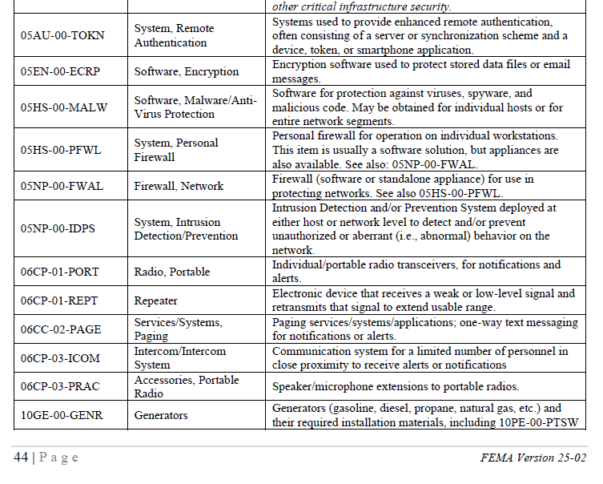
Full list of Allowable Activities and Equipment found in FY 2025 NOFO Authorized Equipment List (AEL)

Slide 15
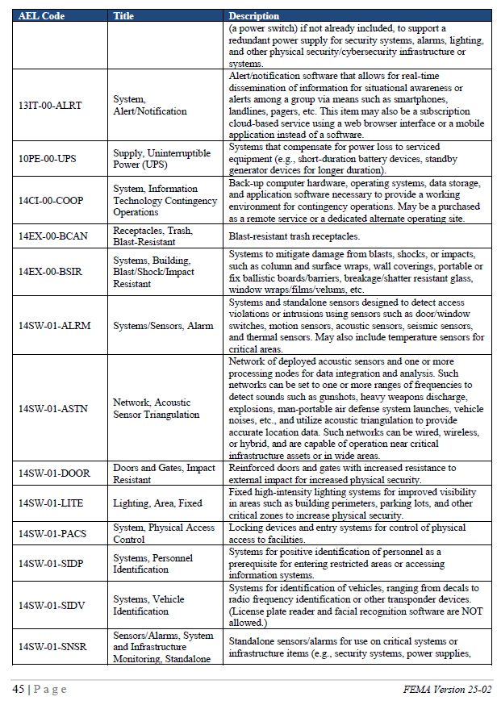
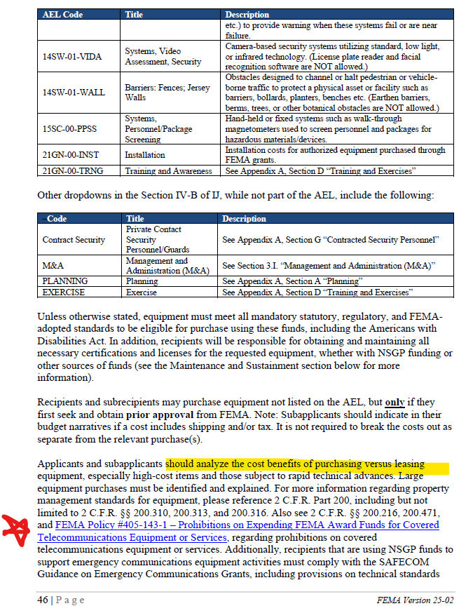
Allowable Activity and Equipment List (AEL) Items Continued

Slide 16
Allowable Activity and Equipment List (AEL) Items Continued
• | 21GN-00-TRNG | Training and Awareness
• | Contract Security | Private Contact Security Personnel/Guards
• | M&A | Management and Administration (M&A)
• | PLANNING | Planning
• | EXERCISE | Exercise
 |  | Additional Considerations:
 |  | Analyze lease vs. purchase costs
 |  | Equipment meets purchase guidelines* (Federal, State, Local) i.e. any maintenance agreements are within the period of performance
 |  | Comply with SAFECOM Guidance on Emergency Comms
 |  | Ensure EHP requirements are met. Email IOEMLogistics@imd.Idaho.gov for more information
Notes:
* 2 C.F.R. Part 200, including but not limited to 2 C.F.R. §§ 200.310, 200.313, and 200.316. Also see 2 C.F.R. §§ 200.216, 200.471, and FEMA Policy #405-143-1 – Prohibitions on Expending FEMA Award Funds for Covered Telecommunications Equipment or Services, regarding prohibitions on covered telecommunications equipment or services.

Slide 17
Environmental Planning and Historic Preservation (EHP) Compliance
Most Projects are likely to require EHP Screening. Projects that include AEL Categories 10, 13, 14 & 15 will require EHP Screening.
Proposed Projects that have the potential to impact the environment, including but not limited to construction, modification, renovation of existing buildings, structures, and facilities must participate in the DHS/FEMA EHP review process. This includes any changes to the structure such as adding security cameras, security doors, security glass, etc.
Projects selected for award will complete and submit the EHP Screening Form to IOEM for EHP review. The FEMA EHP Screening Form must be approved by FEMA prior to starting approved work. Delays in completing the EHP Screening Form will result in delays in the release of grant funds. IOEM will work with Grant Programs Directorate for EHP approval and advise subrecipients regarding release of grant funds.

Slide 18
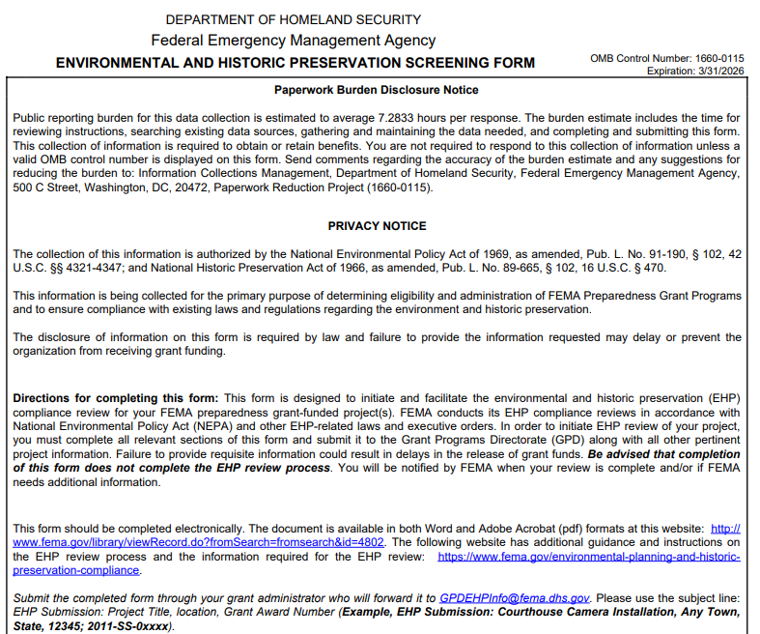

Slide 19
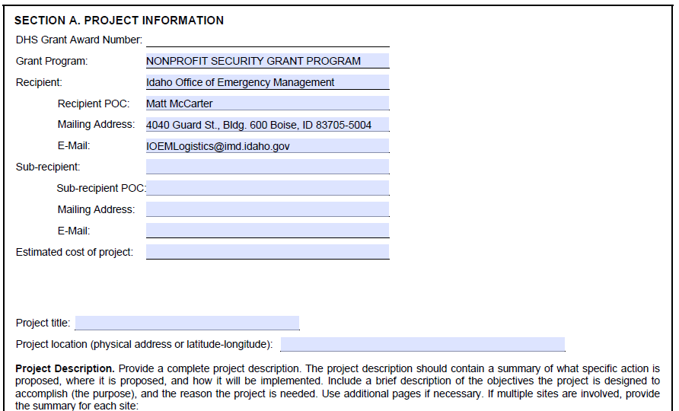
Notes:
Our intention is to provide you a NHP Screening form with the top 6 blocks pre-populated with your Award Package

Slide 20
Prohibition on Telecommunication, Video Surveillance Equipment and Services
Subrecipients may not use any FEMA funds to procure or obtain China made or China affiliated telecommunication, video surveillance equipment or services. Reference FEMA policy #405-143-1 https://www.fema.gov/sites/default/files/documents/fema_policy-405-143-1-prohibition-covered-services-equipment-gpd.pdf
System for Award Management (SAM) provides a consolidated exclusion list of subsidiaries of telecommunication companies https://sam.gov/SAM/
Contact IOEM for assistance in determining if equipment or services are eligible under this program.

Slide 21
2025 NSGP Allowable Costs
Personnel Contracted security protection is the only allowable personnel cost in this category under NSGP.
Funds may not be used to purchase equipment for contracted security.
Applicant must justify proposed contracted security personnel spending in the facility hardening narrative section of the application.
Sustainment planning for non-NSGP-funded contract personnel capability is required as part of IJ narrative and will be revisited in the audit portion of the closeout actions.
i.e. number of personnel, frequency of use, hourly rate
NSGP subrecipients may not use more than 50 percent of their awards to pay for personnel activities unless a waiver is approved by FEMA
Notes:
The nonprofit organization must be able to sustain the contract personnel capability in future years without NSGP funding, and a sustainment plan will be required as part of the closeout package for any award funding this capability. Cap: may not use more than 50% of their awards to pay for personnel activities unless a waiver is approved by FEMA

Slide 22
2025 NSGP Allowable Costs
Management and Administration (M&A)
Up to 5% of a subrecipient’s FY 2024 NSGP award may be used for M&A purposes.
Examples include reporting, financial management, correspondence and monitoring specifically related to grant management.
Justify M&A budget in Section IV-A of the Investment Justification to fully support the proposed budget.
Operational costs are not allowed.
Requests that are simple percentages of the award, without supporting justification, are not allowed.
Notes:
Examples include preparing and submitting required programmatic and financial reports, establishing and/or maintaining equipment inventory, documenting operational and equipment expenditures for financial accounting purposes, and responding to official informational requests from state and federal oversight authorities.

Slide 23
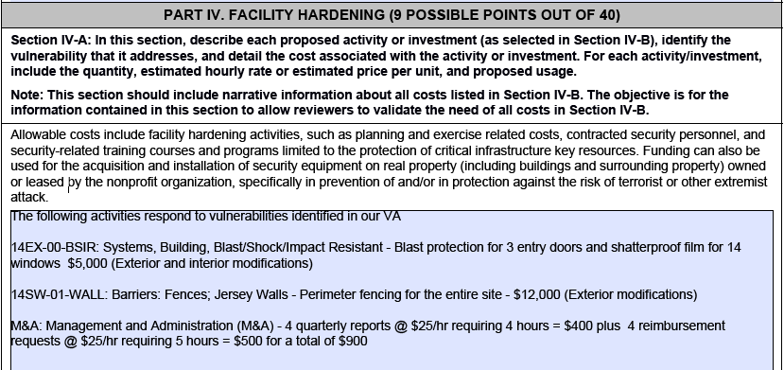
IJ Part IV example

Slide 24
2025 NSGP Unallowable Costs (not exhaustive)
• Organization costs, and operational overtime costs;
• Hiring of public safety personnel;
• General-use expenditure
• Overtime and backfill;
• Initiatives not addressed to NSGP
• The development of risk/vulnerability assessment models;
• Risk or vulnerability security assessments or the development of the IJ;
• Technology development
• Organizational operating expenses;
• Proof of concept initiatives
• Reimbursement of any pre-award security expenses; VA, grant preparation
• Cameras for license plate readers/ license plate reader software;
• Cameras for facial recognition software;
• Weapons or weapons-related training; and
• Knox boxes
Notes:
PGM app C pg C-7

Slide 25
2025 NSGP Application Process
Documents to be submitted to IOEM
Mission Statement: On letterhead, used to validate Investment Justification and to categorize facility (faith-based, education, medical, other).
Completed Vulnerability Assessment (VA): identifies the threats and vulnerabilities specific to the facility / site (occupied and fully operational at the time of application) identified in the application.
Completed Investment Justification (IJ): must be for a physical address- no P.O. Box Numbers, one site and one address per IJ, organization must occupy the site at the time of the application.
Supporting Documentation: supports threat to facility, if applicable, such as police or insurance reports.
Contact information for the person responsible for day to day management of the grant and for the person responsible for financial issues.
Submit via email to IOEMFinance@imd.Idaho.gov
Notes:
Nonprofit organizations must be occupying and fully operational out of the facility listed in their Vulnerability Assessment and IJ at the time of application to be eligible for funding. From FAQ

Slide 26
2025 Investment Justification Form- Important Information
Use only the IJ Form established for FY 2025
Latest version of Adobe Reader required
Use ‘save as’ function after populating the IJ (see naming convention on next slide) and save locally
Browser guidance: Chrome- least friendly, Firefox or Edge most friendly
The correct IJ Form established for FY 2025 is available at Grants.gov with detailed instructions for download in a couple more slides (#29)
Notes:
No browser guidance is in the nofo. According to www.makeuseof.com “The PDF tools in Mozilla's browser are widely considered to be the best outside of dedicated PDF apps.” These forms available

Slide 27
2025 NSGP Application Process File Naming Convention
Mission Statement on letterhead: FY2025_NSGP_S _ID_(Nonprofit name)_MS
Vulnerability Assessment: FY2025_NSGP_S_ID_(Nonprofit facility name)_VA
Investment Justification: FY2025_NSGP_S_ID_(Nonprofit facility name)_IJ
Supporting Documentation: FY2025_NSGP_S_ID_(Nonprofit facility name)_Supporting Documentation
IJs must demonstrate how proposed projects address gaps and deficiencies in current programs and capabilities. Additionally, the IJ must demonstrate the ability to provide enhancements consistent with the purpose of the program and guidance provided by the Federal Emergency Management Agency (FEMA). Nonprofit sub applicants must ensure that the IJ is consistent with all applicable requirements in the IJ form. Each IJ must be for one facility/location.
Notes:
Pending FEMA confirmation of naming as it’s not in the NOFO except for the IJ: Investment Justification: FY2025_NSGP_S_ID_(Nonprofit facility name)_IJ
Nonprofit sub applicants must use the following naming convention when submitting required documents for the NSGP-UA:
“FY2025_NSGP_UA_<State Abbreviation>_<Urban Area>_<Nonprofit Name>; and NSGP-S: “FY2025_NSGP_S_<State
Abbreviation>_<Nonprofit Name>”.
Applications should be submitted by the nonprofit organization to the State Administrative Agency (SAA) as a completed fillable
Adobe file. Scanned copies will not be accepted. Nonprofit sub applicants should contact their respective SAA to get information on
the application deadline and other SAA requirements. If an extension to the deadline is required, nonprofit organizations must
consult with their respective SAA.

Slide 28
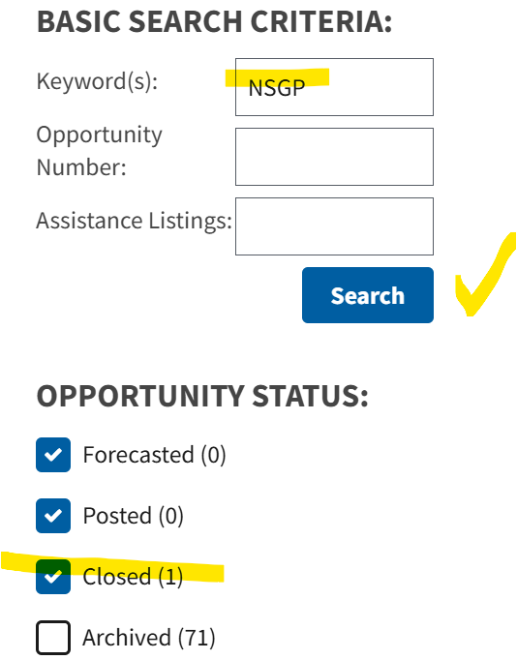


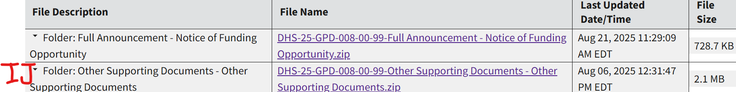
The NSGP IJ form is available at Grants.gov. Obtain a fillable IJ form by:
Navigate to Grants.gov -> Select Search Grants then Classic Search –
Enter NSGP in the Keyword block, click the Closed (#) box below the Search button then click Search –
In Opportunity Number click DHS-25-GPD-008-00-99 –
Click on Related Documents – and note Folder: Other Supporting Documents
IJ click on DHS-25-GPD-008-00-99-Other Supporting Documents - Other Supporting Documents.zip to download the Investment Justification template
This is the FY_2025_NSGP_Investment Justification.pdf file.
Click on the downloaded file to extract the IJ from the zipped file
Right click on the file and Save As “FY2025_NSGP_S_ID_(Nonprofit facility name)_IJ” on your local drive.
NOFO click on DHS-25-GPD-008-00-99-Full Announcement - Notice of Funding Opportunity.zip to download the zip file with the NOFO
Notes:
No browser guidance is in the nofo. According to www.makeuseof.com “The PDF tools in Mozilla's browser are widely considered to be the best outside of dedicated PDF apps.”
The FY24 NSGP Supplemental naming conventions was like FY2024_NSGP-NSS-S_ID_BMH Inc 1st Choice Urgent Care and Family Medicine_IJ

Slide 29
2025 NSGP Application Process
Investment Justification-
Describes the ‘who, what, when, where, why’ and how of the plan to harden targets. (In Part IV narrative, describe which modifications will be external or internal)
Submitted in the required IJ pdf fillable form. All 7 Parts need to be fully addressed.
Submissions in any other format than the provided IJ form are not allowed.
Must be consistent with the findings of the VA and address target hardening initiatives that will mitigate identified vulnerabilities.
Establishes the project timeline and milestones for completion of proposed investments and identifies key individuals that will be involved in implementing and administering the award.
This is the only item IOEM submits to FEMA on your behalf. Make sure you include enough information for FEMA to favorably review your application.

Slide 30
2025 Nonprofit Security Grant Program (NSGP)
To Entity Administrator: On March 3, 2023, only employees of an entity can hold the Entity Administrator role in SAM.gov.
On April 4, 2022, the unique entity identifier used across the federal government changed from the DUNS Number to the UEI number (generated by SAM.gov).
Existing registered entities can find their UEI by following the steps here.
New entities can get their UEI at SAM.gov and, if required, complete an entity registration. I manage an entity. What do I need to do?
For more information about this transition, visit SAM.gov or the Federal Service Desk, FSD.gov. You can search for help at FSD any time or request help from an FSD agent Monday–Friday 8 a.m. to 8 p.m. ET.
Not having a UEI does not prohibit a nonprofit from applying for NSGP, however an award will not be issued until the sub-applicant has established a UEI.
Notes:
SAM.gov | Duns - Sam UEI

Slide 31
2024 NSGP Review Process
SAA Actions Prior to Submitting to FEMA
All required forms submitted: Mission Statement, Completed vulnerability assessment, Completed Investment Justification (IJ), Supporting Documentation, Contact information
Verify eligibility (IRS status, hardening of physical site/s)
Validate organization type using mission statement (faith-based, education, medical or other)
Verify that AEL number aligns with proposed activity
Review and score all complete applications
Rank all applications by funding priorities (level of threat and proposed activities to ameliorate threat, activities aligned to vulnerabilities)
SAA uses a FEMA provided scoring template
SAA reviews prior sub-grantee performance and compliance
Notes:
FEMA provides SAA a scoring template that reviews all entries in the IJ to determine how well the applicant completed the IJ, described their nonprofit, identified their vulnerabilities, aligned their proposed activities to the VA, identified appropriate AEL number, established achievable milestones and timelines and described their anticipated beneficial outcomes. Incomplete submissions or unclear links between VA and IJ entries will lower your likelihood of a successful grant application.

Slide 32
2024 NSGP Review Process
FEMA and IOEM* review priorities-
Investment Justification: describes what vulnerabilities you propose to address with what remedies and a timeline for completion.
Mission Statement: use official letterhead, provide the ‘who, what and why’ of the organization, state purpose of organization and any policies / practices that may elevate risk.*
Vulnerability Assessment (VA): VA is the foundation upon which the IJ is built, the VA addresses threats, vulnerabilities and consequences of potential events at a site or location; equipment should directly link to the threats, vulnerabilities, and potential consequences unique to that site.*
While there are no specific requirements for the VA, applicants are encouraged to engage someone with a security, law enforcement, military or emergency service background to help complete the VA.
(example VA for CISA Houses of Worship Assessment)
*FEMA priority for Mission Statement and Vulnerability Assessment is reflected in FEMA IJ scoring template supplied to SAA
Notes:
*FEMA priority for Mission Statement and Vulnerability reflected in FEMA IJ scoring template used by SAA

Slide 33
2025 NSGP Application Review Process
Three phases of Application Explained: FEMA Review
Secretary
Homeland
Security
IOEM Review
FEMA Review

Slide 34
2025 NSGP FEMA Scoring and Enhancements
FEMA reviews the Investment Justifications in a fashion similar to the SAA review, combines the SAA and FEMA scores, applies a multiplication factor of 3 for ideology-based/spiritual/religious entities; a factor of 2 for medical and educational institutions; and a factor of 1 for all others.
Bonus review points
X3 for ideology-based / spiritual / religious entities (houses of worship, educational institutions, medical facilities, et.
X2 for secular medical and educational institutions
X1 for all other nonprofit organizations
Novice recipients receive +15 points
All applicants are ranked according to their total score and then applications are submitted to the Secretary of Homeland Security for the final decision.
Notes:
FY 24 NOFO NSGP-S Review process pg 39 to 41

Slide 35
2025 NSGP Process Timeline
Bidder’s workshop for potential applicants: 10/15/2025 at 2 am MDT
IJ submission to SAA deadline: 11/21/2025 by 5 pm MDT or 4 pm Pacific Daylight Time (PDT)
Submission email: IOEMfinance@imd.Idaho.gov
Do Not start grant activities prior to Grant Award Notification
No facility modification prior to EHP Screen approval notification
Notes:
NOFO pg 17 Anticipated Award Date: No later than September 30, 2024
Do Not start grant activities prior to Award Notification

Slide 36
FEMA’s Key Takeaways from FY 2023 applications
Duplicative applications: Nonprofits with multiple sites must ensure each IJ reflects an individual site. If you hire a grant writer, review their work. The nonprofit MUST sign the IJ.
Administratively incomplete/insufficient: The FEMA-provided IJ must be submitted. Any incomplete packages will not be reviewed by FEMA.
Unallowable/out of scope expenditures: Ensure that all requested expenditures align with program objectives.
Organizations applying on behalf of ineligible entities: Nonprofits may not act as a pass through for a government or for-profit entity.
Start Early: Nonprofits should consider using currently published materials to begin drafting for the next offering of NSGP.

Slide 37
FEMA’s Key Takeaways from FY 2023 applications (continued)
Threats/Risks/Vulnerability: Nonprofits must tie threats/risks to existing physical vulnerabilities. Must have a potential terrorism/extremism nexus.
Direct hiring: Contract security or any hiring outside the nonprofit CANNOT be sole sourced.
Misaligned or unrealistic narratives, timelines, projects/activities: The IJ content and project goals should be logical, reasonable, and attainable.
Exceeding Published Funding Cap: $200,000 per individual IJ, not to exceed $600,000 per nonprofit organization.
Adobe IJ Form: Technical fixes underway to minimize errors and enhance overall IJ form.
New for FY25 – Investment Justification form now
available on http://Grants.gov

Slide 38
FEMA’s Key Takeaways from FY 2023 applications (continued)
Explore Peer to Peer Support: Leveraging partnerships and engage with successful nonprofits.
Vulnerability Assessments: Should be refreshed every 5 years, sooner if substantive changes in vulnerability, and/or safety/security posture.
Bookmark State Administrative Agency (SAA) Website: Nonprofits should have their SAA’s website and contact information bookmarked.
Conflict of Interest: Avoid any actual or perception of conflict between grant writers/consultants and contractors/vendors executing post award activities.

Slide 39
Expectations for Successful Applicants
Successful Applicants will receive an Award Notification package after IOEM receives FEMA Award Notification.
Successful Applicants are expected to participate in a “Kick Off” meeting that will include representatives from IOEM and the Applicant’s “Day to Day” Project Manager and Financial Manager. This meeting will explain reporting requirements, reimbursement procedures and ancillary FEMA requirements such as completion of the Environmental and Historical Protection Screen.
No facility modifications should begin prior to receiving an Award Notification document and receiving FEMA approval notification of your Environmental and Historical Protection Screen.

Slide 40
Questions:
Matt McCarter Kari Harneck
Grants Branch Chief Finance Section Chief
IOEM IOEM
mmccarter@imd.Idaho.gov Kharneck@imd.Idaho.gov
(208)258-6517 (208)258-6564
Luis Magdelano
Grant Finance Specialist
IOEM
lmagdelano@imd.Idaho.gov
(208)258-6529
Val Mills
IRC:208-947-7891
Volunteer Logistics Support
vmills@imd.Idaho.gov
Office Hours Tue-Thu 1pm-4pm

