Slide 1
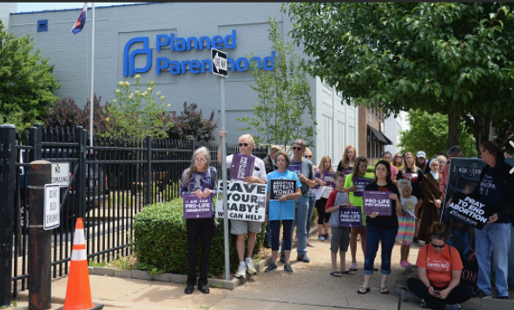
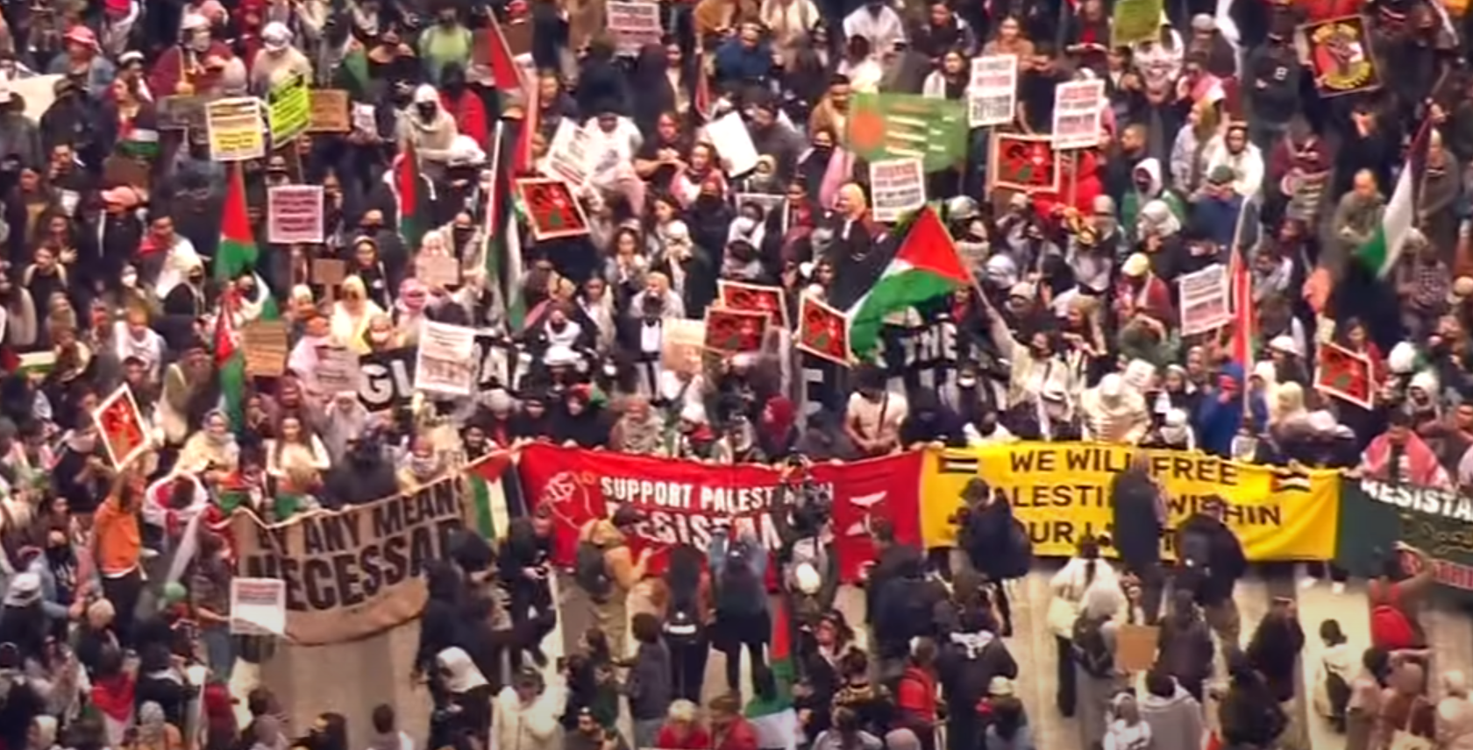

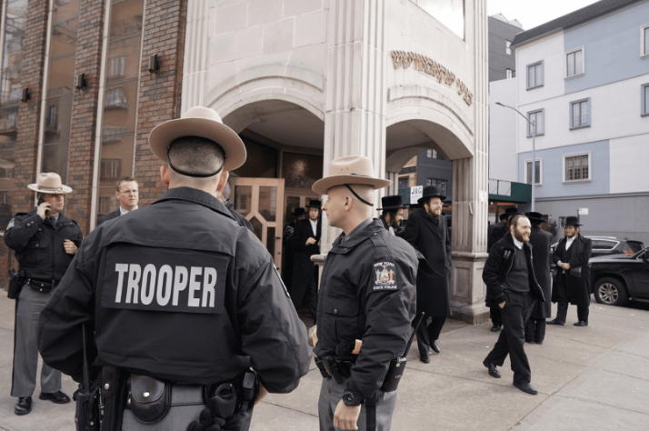
2024 Nonprofit Security Grant Program (NSGP)
Subrecipient Procedures Kickoff
10:00 a.m. Monday October 21, 2024

Slide 2
Goals for the Morning
Celebrate! Congrats on your awards
Review guidance on programmatic and financial management of your grants
Clarify requirements
Introduce GMS
Introduce reimbursement procedures
Answer questions
No facility modifications should begin prior to receiving a Grant Award Notification document and receiving FEMA approval notification of your Environmental and Historical Protection Screen.

Slide 3
2024 Nonprofit Security Grant Program (NSGP) Guidance
Guidance and implementation procedures come the following resources.
FY24 NSGP NOFO / Guidance / Quick Start / FAQ
The U. S. Department of Homeland Security (DHS) Notice of Funding Opportunity (NOFO) Fiscal Year 2024 Nonprofit Security Grant Program | FEMA.gov
Fiscal Year 2024 Nonprofit Security Grant Program – FAQ
Fiscal Year 2024 Nonprofit Security Grant Program (NSGP) Subapplicant Quick Start Guide | FEMA.gov
Preparedness Grants Manual(page 83)
FY24 NSGP Subrecipient Guidance

Slide 4
Expectations for Successful NSGP Applicants
Some Sub-recipients have a hold on some portion of their award. We have contacted each of these Sub-recipients and are working with FEMA to resolve issues that necessitated these holds. When the issues are resolved, the funds will be released.
2024 NSGP AWARDS WITH HOLDS
Awarded | Amount Awarded | Amount Awarded | On Hold | County
Central Assembly Christian Life Center | $ 16,206 | $ 16,206 | $ 16,206 | Ada
Capital Christian Center, Inc. | $ 150,000 | $ 150,000 | $ 4,480 | Ada
Museum of Idaho - ID Falls | $ 110,238 | $ 110,238 | $ 5,000 | Bonneville
Valor Health Specialty Surgery | $ 75,300 | $ 75,300 | $ 15,000 | Gem
Kootenai Health, Inc - Main Campus | $ 149,889 | $ 149,889 | $ 148,889 | Kootenai
 | $ 501,633 | $ 501,633 | $ 189,575
AWARDS WITH HELD FUNDS WILL NOT BE SET
UP IN GMS UNTIL HOLDS ARE RELEASED

Slide 5
2025 Nonprofit Security Grant Program (NSGP) Guidance
It is important not to expend any of these funds until a Grant Award Notice has been signed by your official and countersigned by IOEM’s Bureau Chief. You can expect to receive instructions from the Finance Section of the Idaho Office of Emergency Management regarding instructions on how to file for reimbursement of grant expenditures.

Slide 6
All grants will have periodic Monitoring.
Monitoring may be in the form of emails, phone calls, desk reviews or site visits. Quarterly reports and financial records are also monitored for timeliness and accuracy. Monitoring is intended to:
Identify areas of need for technical assistance and guidance
Review artifacts, policies, ledgers, and other documentation to assure compliance with 2 CFR 200
Identify and document bright spots / great practices
Build relationships
Contribute to smooth audits
Assure the SAA and subrecipients adhere to grant guidelines

Slide 7
Environmental Planning and Historic Preservation (EHP) Compliance
Most Projects are likely to require EHP Screening. Projects that include AEL Categories 10, 13, 14 & 15 will require EHP Screening.
Proposed Projects that have the potential to impact the environment, including but not limited to construction, modification, renovation of existing buildings, structures, and facilities must participate in the DHS/FEMA EHP review process. This includes any changes to the structure such as adding security cameras, security doors, security glass, etc.
Projects selected for award will complete and submit the EHP Screening Form to IOEM for EHP review and then forwarded to FEMA. The FEMA EHP Screening Form must be approved by FEMA prior to starting approved work. Delays in completing the EHP Screening Form will result in delays in the release of grant funds.
Notes:
AFO discussion.

Slide 8
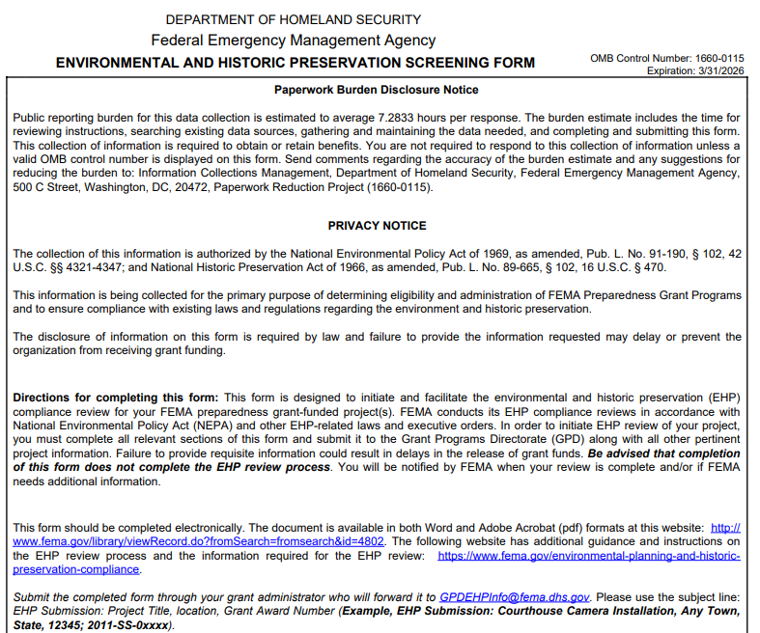

Slide 9
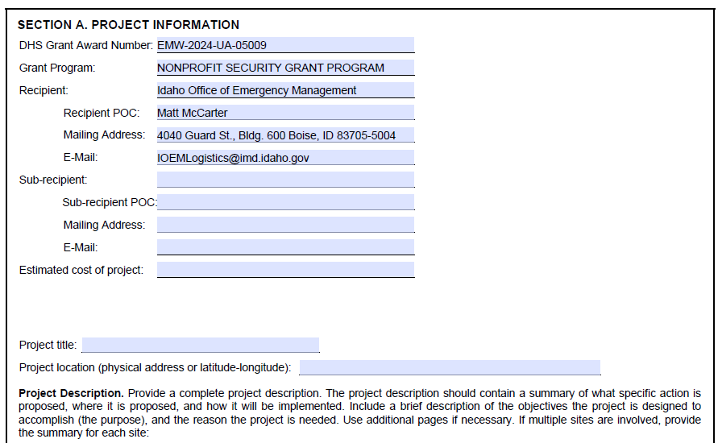
Notes:
Our intention is to provide you a EHP Screening form with the top 6 blocks pre-populated with your Award Package

Slide 10
Prohibition on Telecommunication, Video Surveillance Equipment and Services
Subrecipients may not use any FEMA funds to procure or obtain China made or China affiliated telecommunication, video surveillance equipment or services. Reference FEMA policy #405-143-1 https://www.fema.gov/sites/default/files/documents/fema_policy-405-143-1-prohibition-covered-services-equipment-gpd.pdf
System for Award Management (SAM) provides a consolidated exclusion list of subsidiaries of telecommunication companies https://sam.gov/SAM/
Contact IOEM for assistance in determining if equipment or services are eligible under this program.

Slide 11
2025 NSGP Allowable Costs
Personnel- Contracted security protection is the only allowable personnel cost in this category under NSGP.
Funds may not be used to purchase equipment for contracted security.
Applicant must justify proposed contracted security personnel spending in the facility hardening narrative section of the application.
Sustainment planning for non-NSGP-funded contract personnel capability is required as part of IJ narrative and will be revisited in the audit portion of the closeout actions.
i.e. number of personnel, frequency of use, hourly rate
NSGP subrecipients may not use more than 50 percent of their awards to pay for personnel activities unless a waiver is approved by FEMA
Notes:
The nonprofit organization must be able to sustain the contract personnel capability in future years without NSGP funding, and a sustainment plan will be required as part of the closeout package for any award funding this capability. Cap: may not use more than 50% of their awards to pay for personnel activities unless a waiver is approved by FEMA

Slide 12

How to Apply- NEW Application Process
FY25 AMPLIFUND is the new grant management system
To Register on the Idaho Grant Management System
Idaho Grant Management System (GMS) of record (Amplifund) is online at: https://gotomygrants.com.
Activation of account (and reset password) email comes from no-reply@gotomygrants.com and
E-Signature requests come from ElectronicSignature@sign.amplifund.com.
See also Attachment 1. SHSP-23 Subgrantee Guidance IOEM Subrecipient AmpliFund User Guide_2025 v1
Guide available by email from vmills@imd.Idaho.gov or on the shared drive at H:\BHS FINANCE\Grants\2025\2025 SHSP\3-Guidance
Notes:
9/2/25

Slide 13
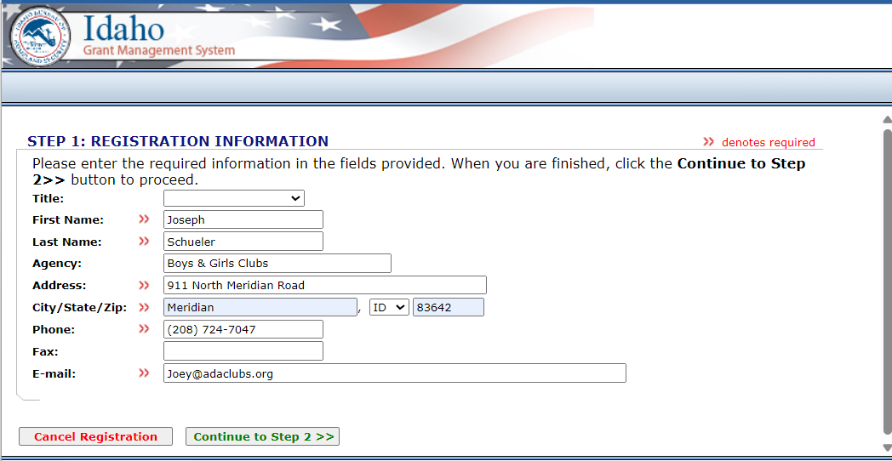
This should take you to a screen like this
Enter your information and select “Continue to Step 2”
to complete your registration

Slide 14
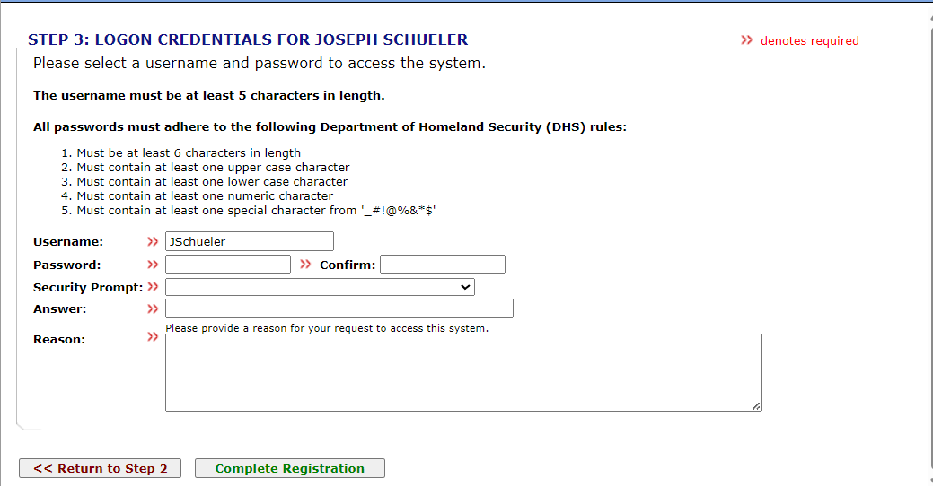
That will bring you here. Enter and confirm your password and other information and select “Complete Registration”

Slide 15
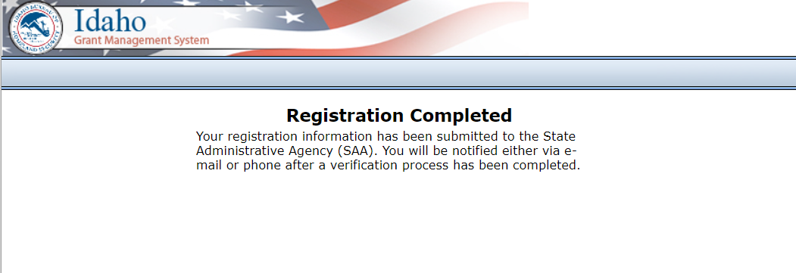
You should see this
When you get to this point an email will go to a Grants Finance Specialist. The Specialist will set up your grant in GMS and allow you access to GMS to view your grant documents where you will enter your grant information.

Slide 16
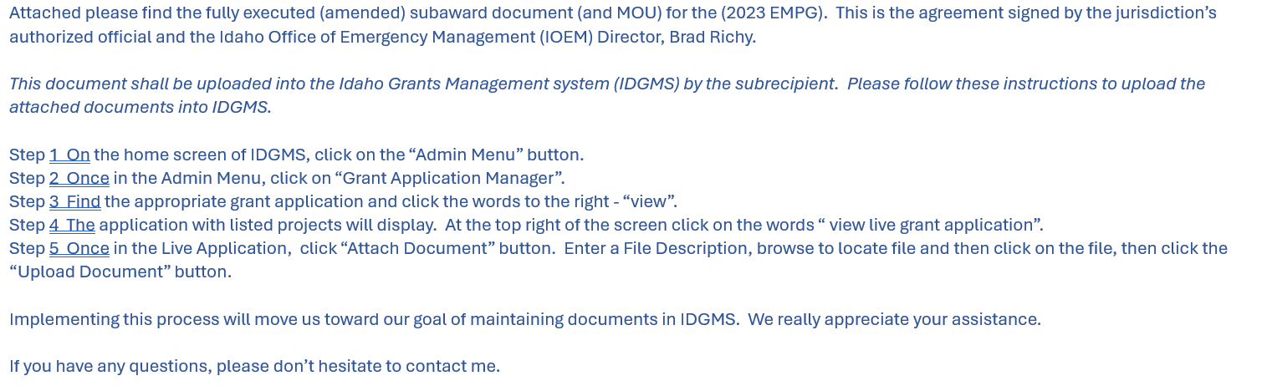
The email will look something like this. Follow the instructions to enter your information.
After you have completed your document upload, you will enter the information from your IJ.

Slide 17
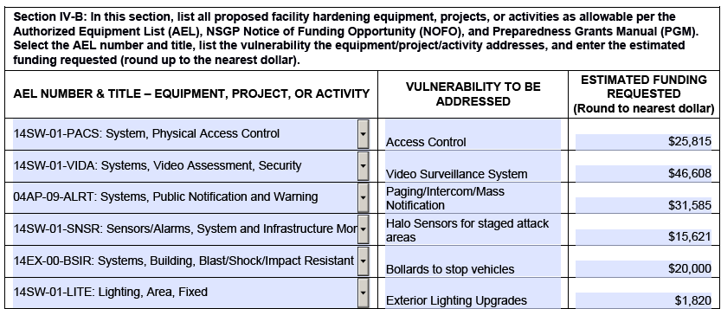
You will enter information that will come directly from the Investment Justification (IJ) you prepared to receive this grant. Information from Section IV-B is an example.

Slide 18
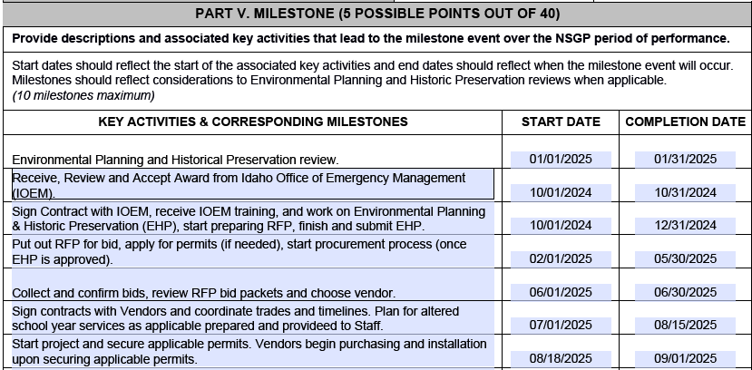
You will also enter your stated Milestones from Part V.

Slide 19
No facility modifications should begin prior to receiving a Grant Award Notification document and receiving FEMA approval notification of your Environmental and Historical Protection Screen. When those are completed, you will receive an email. Then you can begin work.

Slide 20
IOEM support is available to help if you have questions.
Matt McCarter Kari Harneck
Grants Branch Chief Finance Section Chief
IOEM IOEM
mmccarter@imd.Idaho.gov Kharneck@imd.Idaho.gov
(208)258-6517 (208)258-6511
Joe Roth
Community Preparedness Coordinator
IOEM
jroth@imd.idaho.gov
208-986-2514
Val Mills
Logistic Support
IOEM (Tue-Thu 1-4pm)
vmills@imd.Idaho.gov
(208)947-7891
Notes:
9.2.25

